Slide 1
CSS Text Properties
Mr. Mack 2021

Slide 2

CSS Zen Garden

Slide 3
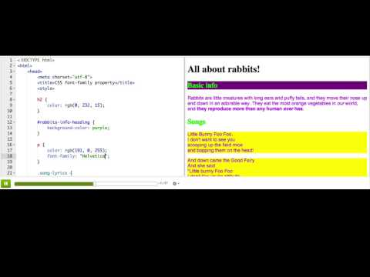
CSS font-family property

Slide 4
Practice: Fancy font families
This webpage displays the theme songs from a few famous TV families. Each of the lyrics paragraphs have id's, but the CSS rules for them have no properties yet. Add a font-family property to each of the CSS rules, using a generic family name that works for all computers. Choose a different font family for each rule.
Here's a list of generic font families: sans-serif, serif, fantasy, monospace, and cursive.
Change the font families

Slide 5

Practice: Fancy font families
Remember how to use element selectors from CSS Basics? Use the body selector to make a new CSS rule that changes the font-family of the entire page.
Change the base font family

Slide 6
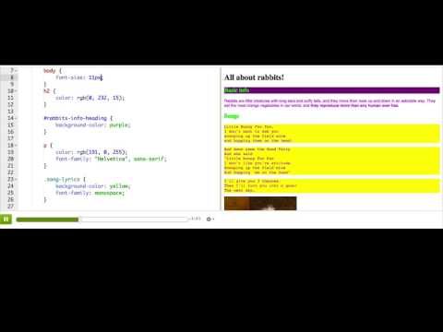
CSS font-size property

Slide 7
Practice: Great big font sizes
This webpage includes lyrics from a song about big words. We've put 'big' and 'bigger' classes on the <em>'s that describe big words, but we haven't styled them. Add a property to their CSS rules to make the size of the 'big' words big, and the size of the 'bigger' words even bigger. Use the same units for both properties.
Make big font sizes

Slide 8
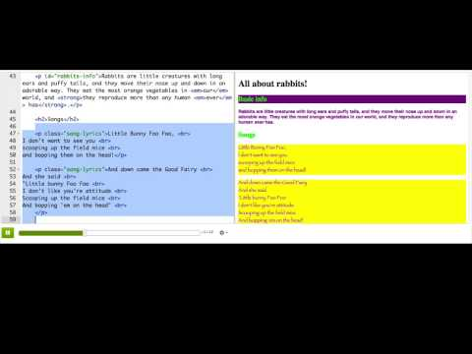
CSS font styles and shorthand

Slide 9

Practice: Famous font formats
This webpage displays some famous quotes and declarations from movies and TV shows. Add a CSS rule that makes all of the quotes have an italic font style, so they'll look more like quotes.
Make italic quotes

Slide 10
Practice: Famous font formats
Add a CSS rule that makes all of the declarations have a bold font weight, so they'll look like they were said in a loud voice.
Make bold declarations

Slide 11
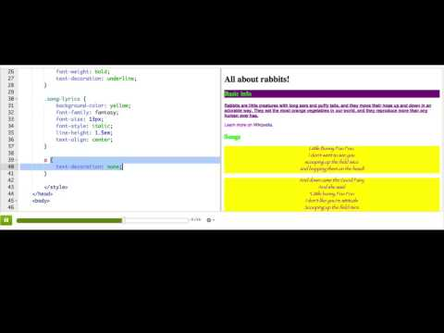
More CSS text properties

Slide 12
What CSS property would you use to make text bold?
Choose 1 answer:
font-weight
font-style
text-decoration
font-family
Notes:
🍐 This is a Pear Deck Multiple Choice Slide. Your current options are: A: font-weight, B: font-style, C: text-decoration, D: font-family,
🍐 To edit the type of question or choices, go back to the "Ask Students a Question" in the Pear Deck sidebar.
A

Slide 13
Which of the following are valid units for the font-size property in CSS?
Em
Px
Kg
lb
Notes:
🍐 This is a Pear Deck Text Slide
🍐 To edit the type of question, go back to the "Ask Students a Question" in the Pear Deck sidebar.
A+B

Slide 14
You want to style the code blocks on a webpage using a monospace font, and your preferred font is "Courier".
Which of these shows the best way to specify the font-family property?
font-family: monospace, "Courier";
font-family: "Courier";
font-family: "Courier", sans-serif;
font-family: "Courier", monospace;
font-family: "Monaco", monospace, "Courier";
Notes:
🍐 This is a Pear Deck Multiple Choice Slide. Your current options are: A: A, B: B, C: C, D: D, E: E,
🍐 To edit the type of question or choices, go back to the "Ask Students a Question" in the Pear Deck sidebar.
D

Slide 16
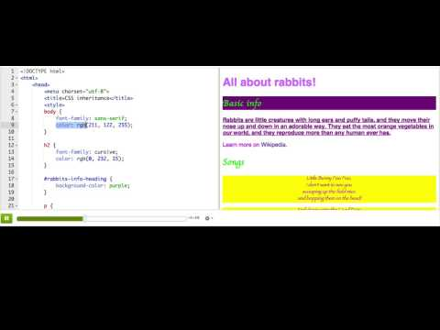
CSS inheritance

Slide 17
Challenge: Blog
A "blog" (or "web log") is an online journal, which one or multiple people update on a frequent basis, like daily, weekly, or monthly. Many new programmers keep blogs to document their journey to becoming a programmer, with updates on what they've learned and what they've made.
There are many "blogging engines" out there, like WordPress and Blogger, but in this project, you'll make your own blog using HTML and CSS. It should have at least 2 entries, and the table of contents should internally link to each entry. Use CSS text properties to style your blog - like changing the font family, line height, and font styles of various sections.
If you like your blog, then you could use it to document your journey here - make it a featured project on your profile, then people that visit your profile will get to read about your journey!
Good Luck!

Slide 18
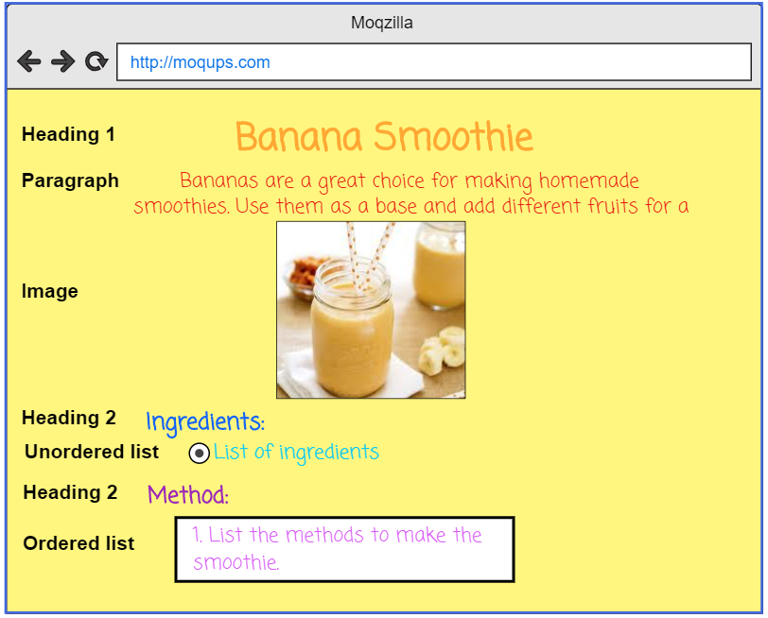


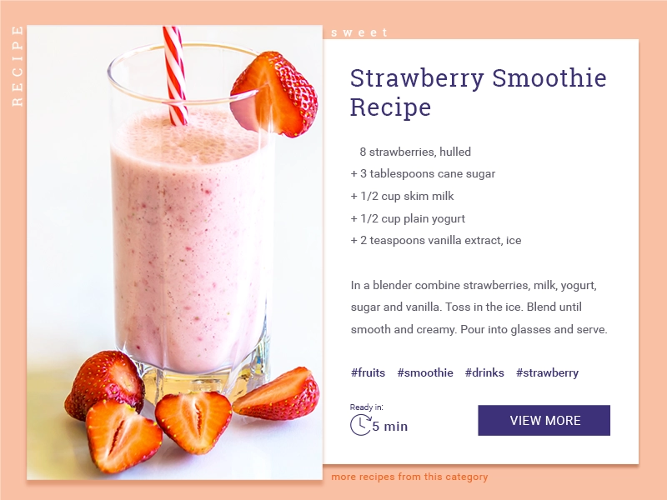
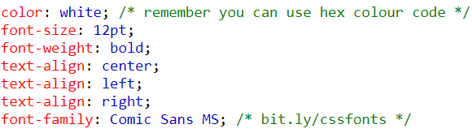

MAKE A RECIPE! (CSS)
START HERE
CREATE YOUR OWN RECIPE CARD USING HTML AND CSS!
Edit your recipe card using style.css
Using the CSS tags add format to your recipe; add background colour or picture, coloured font, size of image or text centered, left or right etc. Be creative!
In this activity, you will continue to edit your recipe . You will be introduced to six common CSS tags; font colour, size, family and alignment. Change background colour and image size.
Here’s a list of some CSS properties you can use:
FINISHED?
Publish your recipe on Google classroom.
Help a neighbour!
Use hex colour codes bit.ly/hexColour
Challenge yourself! Research how to add a link to a website or insert a YouTube video.
Credit to Code Club projects for this activity.
Notes:
Once pupils have made their recipe page using their HTML tags. Next pupils will be introduced to the CSS tags and how to write them; changing the element. This is a good opportunity to show hex colours as well. I would only show S1/2 pupils external CSS this is just a personal preference as I think it’s let confusing for pupils by having the two seperate pages and gets them into good practice. When I revist web design in S3 I would then go onto demonstrate internal css.
OBJECTIVES
By completing this activity, students will:
Become more familiar with editing css.
Be exposed to common css tags.
I would get pupils to open their HTML recipe page that they completed and I would open one that I have made as well to demonstrate. I would then draw their attention to the <link rel="stylesheet" href="style.css"> line on their page and go over what CSS is. I would point out that this is linking to the page style.css and that this is used to change the family font, font size etc. Just like the lesson before I would talk them through and demonstrate on my own html recipe what would happen with each type of css property illustrated on the slide. I would involve the class by asking them to give me a colour etc. I always demonstrate to pupils blue as it’s my favourite colour but tell them that I don’t actually like that particular shade so then go onto show them hex colour code that gets that excited usually. Or another good one to show them is gold as it just looks a bit orangey it’s not great so hex is a better option. I emphasis that hex colour codes can be used for colour of text as well not just the background of the page etc.
Task - Once I have demonstrated and we’ve had class discussion about the css properties I would then set the class the challenge. They have to now have font colour, background colour and an image to their recipe they can have a different colour of each piece of text if they wish it’s up to them. I really enjoy keeping tasks open for pupils to allow for creativity.

